Slide 1
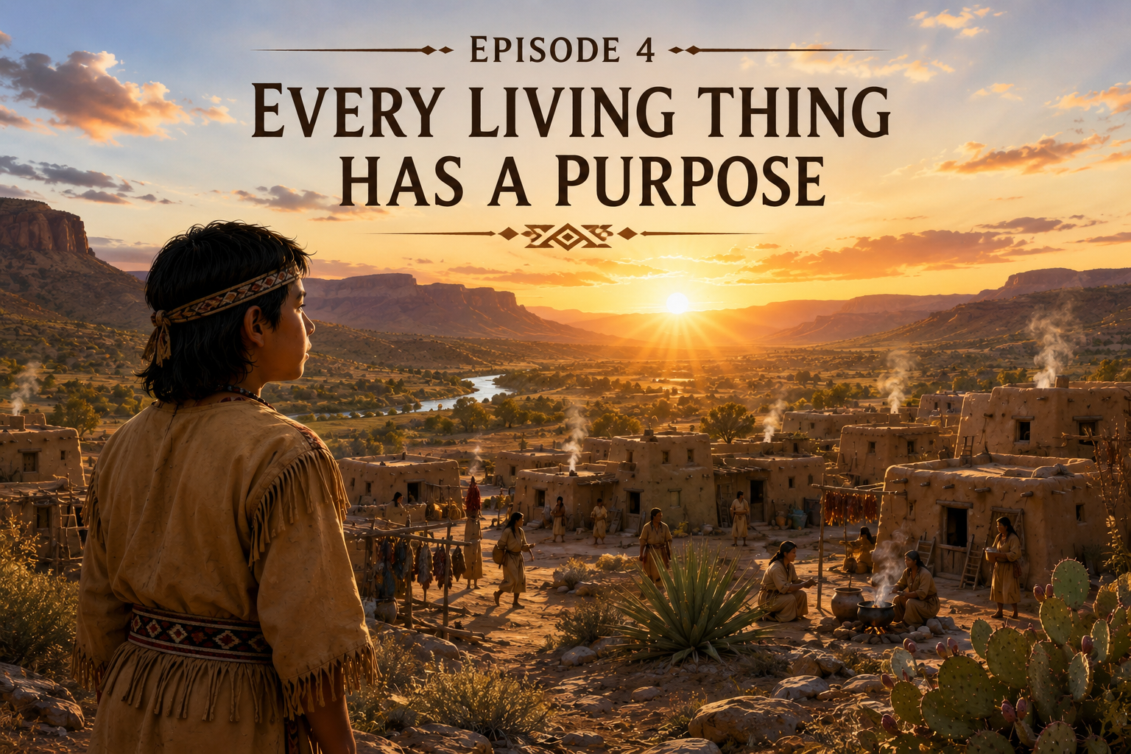

Notes:
These presentations are based on historical research compiled by Felix Salmeron, Jumano Elder. They are inspired by the traditions, values, and oral teachings of the Jumano people and are presented in the spirit that knowledge was shared from one generation to the next. This work is dedicated to preserving Jumano history so future generations will remember who the Jumano people were, and who they continue to be.
Come, walk with me through the homeland of the Jumano people, where every trail has a story, every mountain holds a memory, and every living thing has a purpose.
These presentations are based on historical research compiled by Felix Salmeron, Jumano Elder. They are inspired by the traditions, values, and oral teachings of the Jumano people and are presented in the spirit that knowledge was shared from one generation to the next.
This work is dedicated to preserving Jumano history so that future generations will remember who the Jumano people were, and who they continue to be.
As the first light of morning reaches across the desert, the Jumano village awakens. Smoke rises gently from adobe homes, birds greet the new day, and the cool breeze carries the fragrance of mesquite and sage.
For the Jumano people, every sunrise was a gift from the Creator—a reminder that another day had been given to learn from the land, to care for one another, and to live in harmony with all living things.
Today, we begin another journey with young Manito. He will not teach us with words. Instead, he will teach us by watching, by listening, and by learning from the world around him... just as Jumano children have done for generations.
Come... let us begin.
The Story

Slide 2
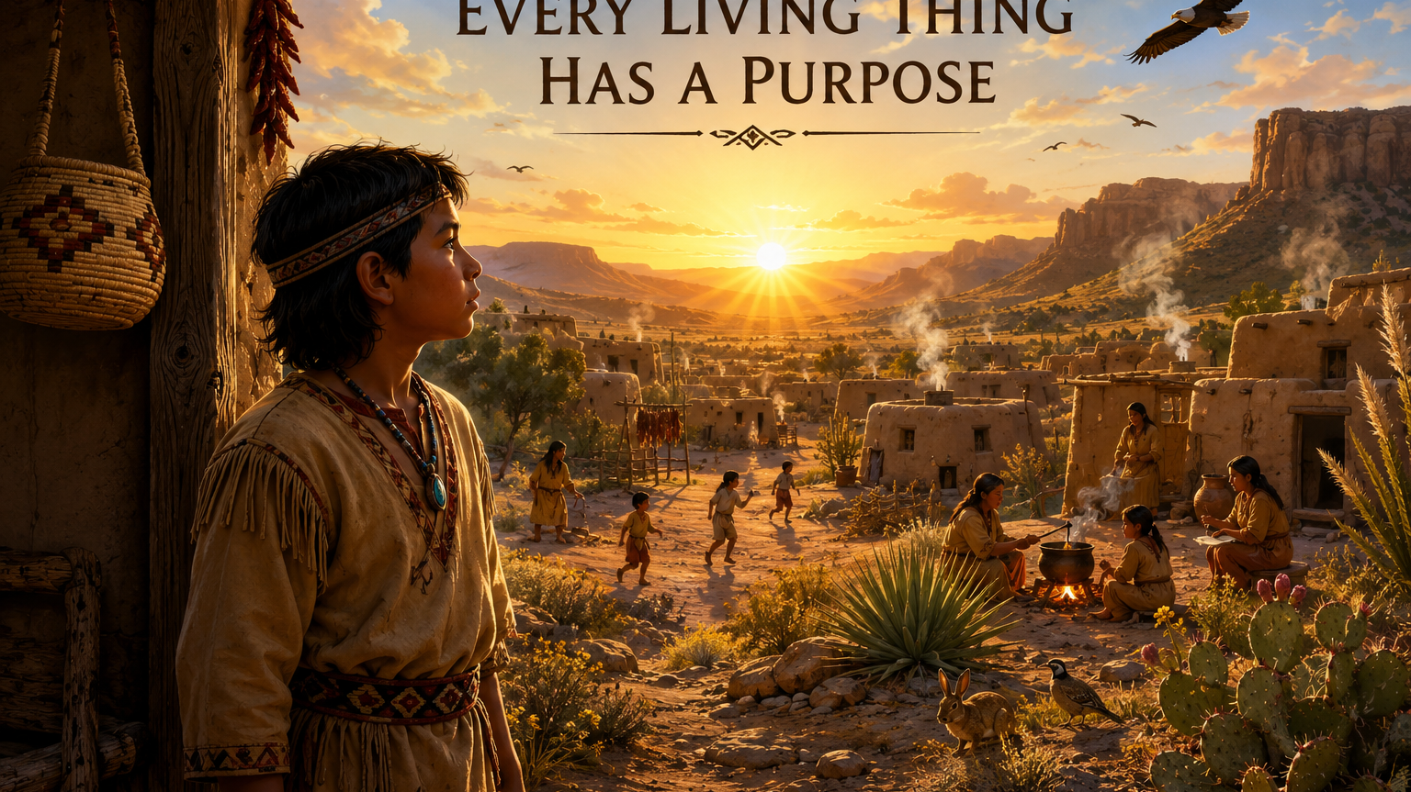
Notes:
Soft Native flute plays. The desert awakens as the sun rises over the Jumano village.)
Narrator:
"The morning sun climbed slowly above the eastern horizon as Manito walked beside one of the respected elders of his village.
Among the Jumano people, wisdom was not hurried. It was shared one step at a time, one season at a time, and one generation at a time.
Children learned by observing the world around them. They watched the changing seasons, listened to the sounds of the desert, and discovered that every living thing had a place within the Creator's design.
As they walked beyond the village, the elder said very little.
He understood that the greatest teacher was not himself.
The greatest teacher was the land.
And today, the land was about to share another lesson."

Slide 3
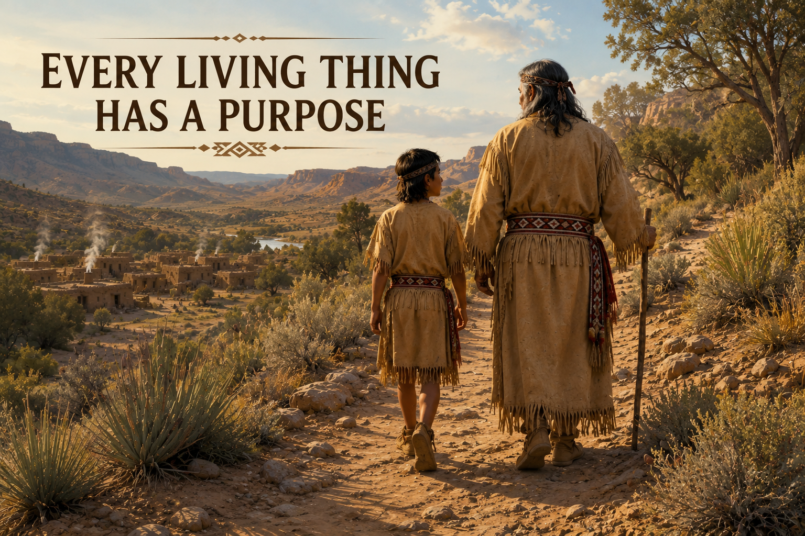

Slide 4
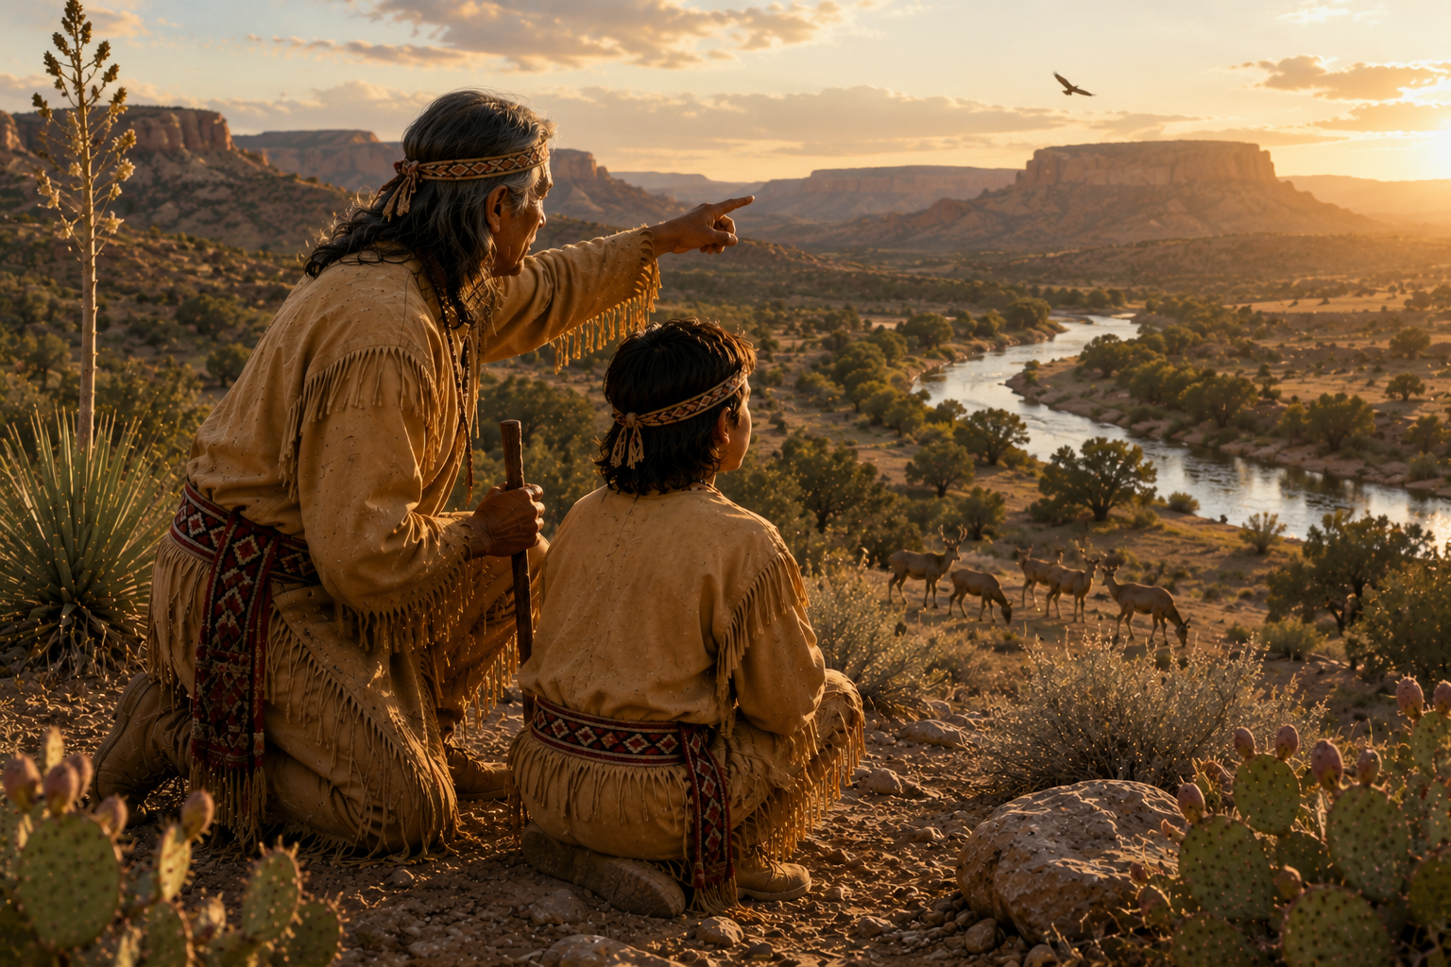
Notes:
heir journey led them away from the village and into the quiet desert.
After walking for some time, the elder stopped beside a small desert shrub.
He did not begin with words.
Instead, he knelt beside the plant and carefully examined its leaves, allowing Manito to watch every movement.
Among the Jumano people, learning often began with patience.
Before understanding could come, there had to be careful observation.
The plants of the desert were more than part of the landscape. They provided food, medicine, shelter, and materials for everyday life. To know the land was to know how to live upon it.
Manito watched closely.
Without speaking, he was beginning to understand that even the smallest plant had a purpose."

Slide 5
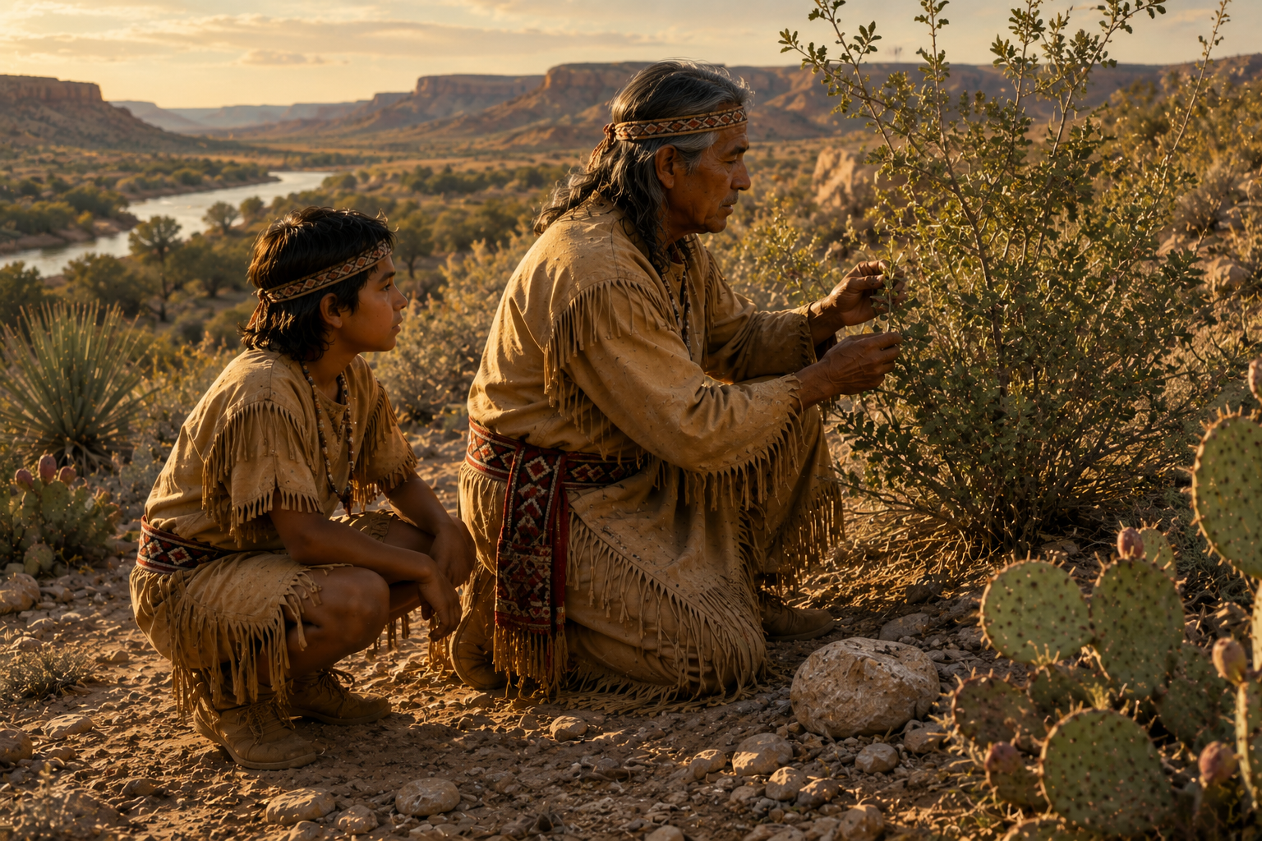

Slide 6
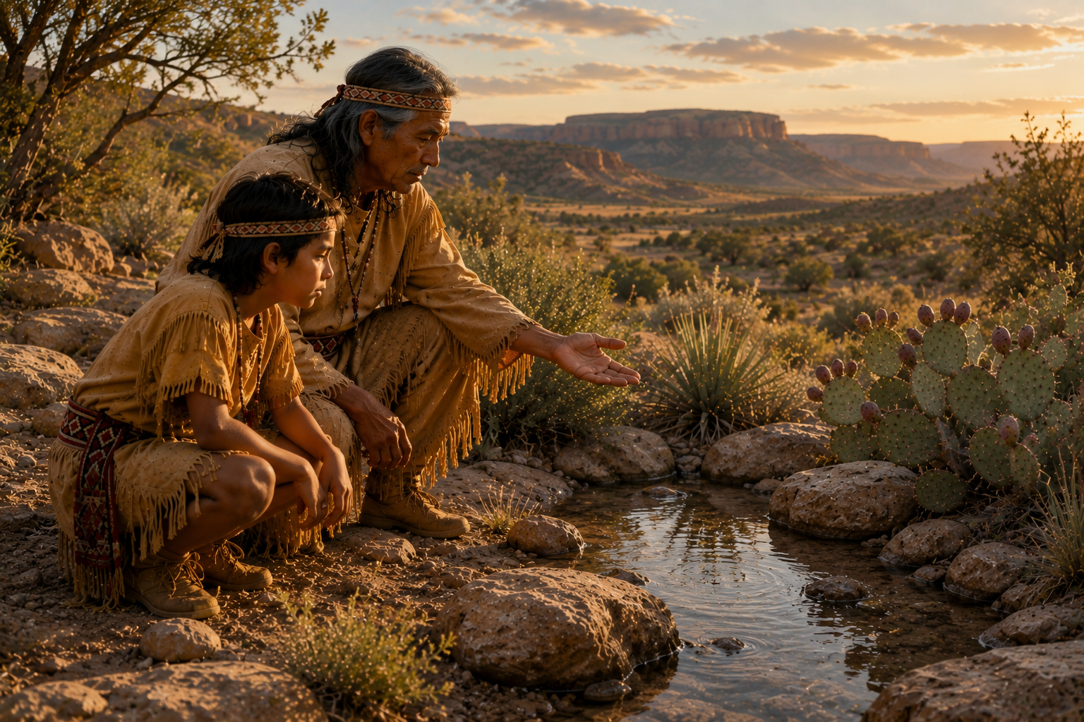
Notes:
"Before them, a small stream flowed quietly through the desert.
To many people, it might have seemed like nothing more than a narrow ribbon of water.
But to the Jumano people, water was life.
Where water flowed, plants took root.
Where plants grew, animals found food and shelter.
And where animals gathered, people could also find the things they needed to live.
The elder lowered his hand toward the stream, inviting Manito to observe.
There was no need for many words.
The flowing water was telling its own story.
As Manito watched the current move gently around the stones, he began to understand that even the smallest stream could nourish an entire world.
Every living thing depended upon it.
And every living thing had a purpose."

Slide 7
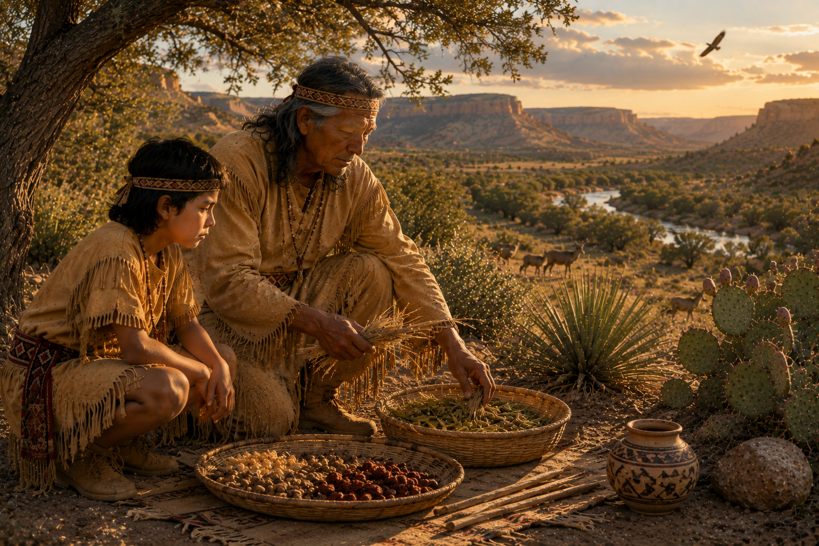
Notes:
Every gift from the land was treated with respect.
The Jumano people understood that what was gathered from nature should never be wasted. Plants, seeds, fruits, grasses, and fibers each served a purpose, providing food, medicine, clothing, baskets, tools, and countless other necessities of daily life.
The elder carefully sorted the day's gathering, taking only what was needed.
Manito watched each movement with quiet attention.
No lesson was hurried.
No words were necessary.
By observing the elder's patience and care, he learned that wisdom was found not only in knowing what to gather, but in knowing how to honor the gifts that the Creator had provided.
Respect for the land began with gratitude.
And gratitude began with understanding."

Slide 8
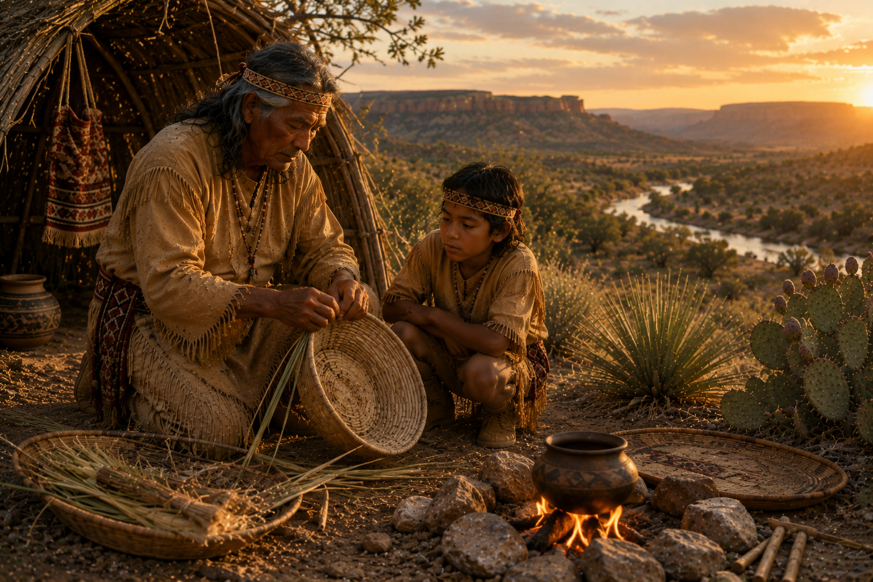
Notes:
As the day drew to a close, the lessons of the land continued.
What had been gathered with care was now prepared with patience.
The elder's hands moved slowly, weaving each strand into a strong basket. Nothing was hurried. Every movement reflected years of experience and respect for the gifts of the Creator.
Manito watched quietly.
He was learning that knowledge was not measured by how much a person could say, but by what a person could do.
Every basket began with a single strand.
Every skill began with a single lesson.
And every lesson became part of the wisdom that one day would be passed to the next generation.
In this way, the knowledge of the Jumano people lived on—not

Slide 9
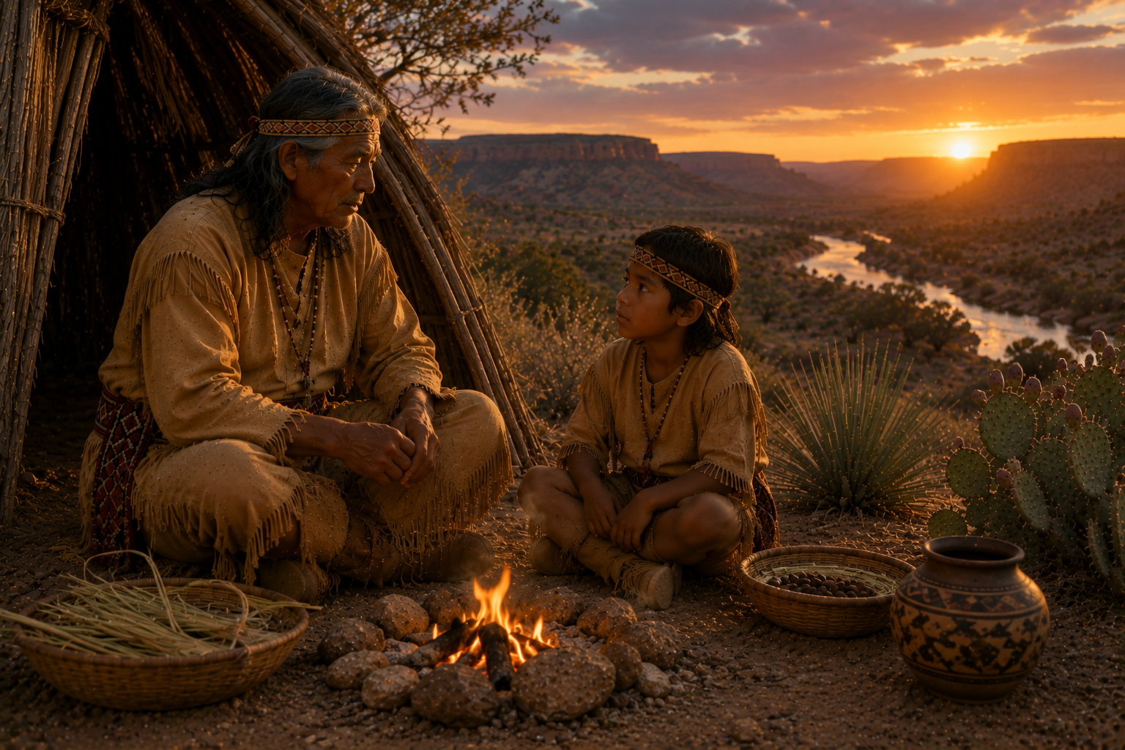
Notes:
As the day drew to a close, the lessons of the land continued.
What had been gathered with care was now prepared with patience.
The elder's hands moved slowly, weaving each strand into a strong basket. Nothing was hurried. Every movement reflected years of experience and respect for the gifts of the Creator.
Manito watched quietly.
He was learning that knowledge was not measured by how much a person could say, but by what a person could do.
Every basket began with a single strand.
Every skill began with a single lesson.
And every lesson became part of the wisdom that one day would be passed to the next generation.
In this way, the knowledge of the Jumano people lived on—not only through words, but through the work of their hands."

Slide 10
Notes:
s evening settled across the Jumano homeland, another day of learning came to an end.
The work of the day was finished, but the lessons remained.
The elder and Manito rested quietly beside the warmth of the fire.
Neither felt the need to fill the silence with words.
Among the Jumano people, silence was never empty.
It was a time to remember.
A time to reflect.
A time to give thanks for the gifts the Creator had placed upon the land.
As the last light disappeared beyond the western mesas, Manito carried with him more than memories of the day's journey.
He carried a deeper understanding that every plant, every stream, every animal, and every person shared a place within the great circle of life.
The elder had taught without many words.
The land had done the teaching.
And Manito had learned."

Slide 11
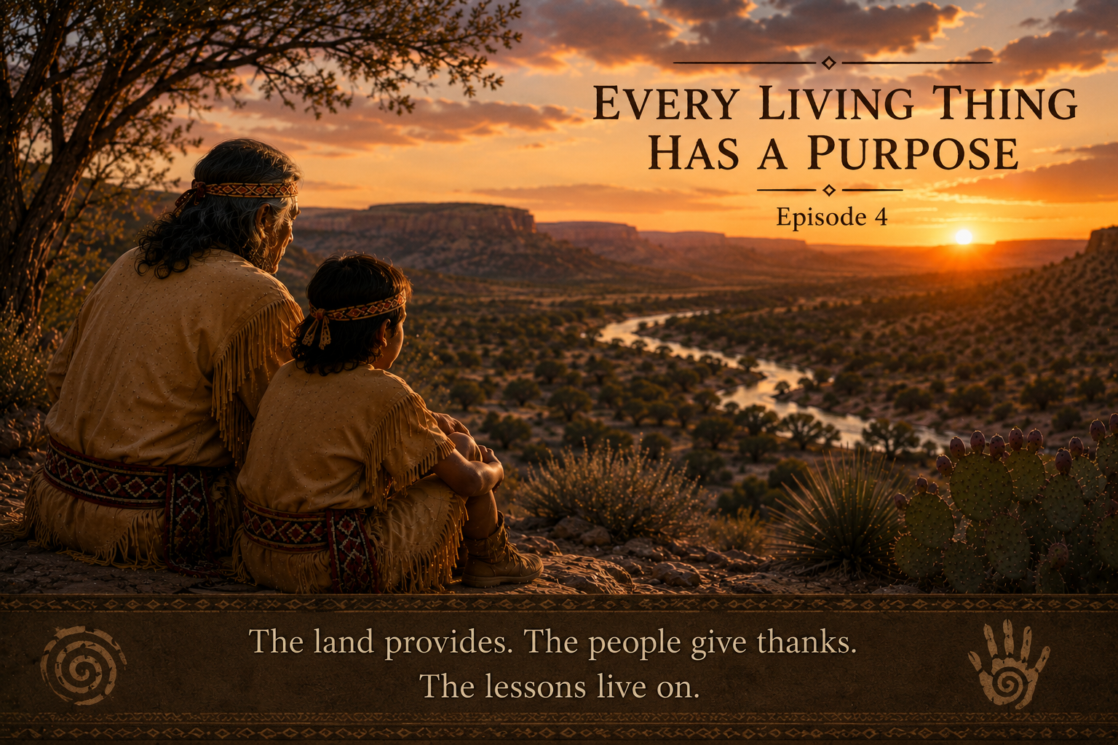
"The land provides.
The people give thanks.
The lessons live on."
Notes:
"The sun now rests beyond the western mesas, and another day has come to its end.
For the Jumano people, each day brought new opportunities to learn from the Creator's world.
The land gave food.
The streams gave water.
The plants gave medicine and materials.
The animals provided what was needed for life.
Nothing was taken without gratitude.
Nothing was wasted without purpose.
As Manito looked across the quiet valley, he understood that the greatest lesson of the day was not about a single plant, a stream, or an animal.
It was about respect.
Respect for the Creator.
Respect for the land.
Respect for every living thing.
These were the teachings that shaped the Jumano people for generations.
May we remember them.
May we honor them.
And may we continue to learn from the land, just as our ancestors did."

